Slide 1

Makimbetov Emil
MD, professor

Slide 2
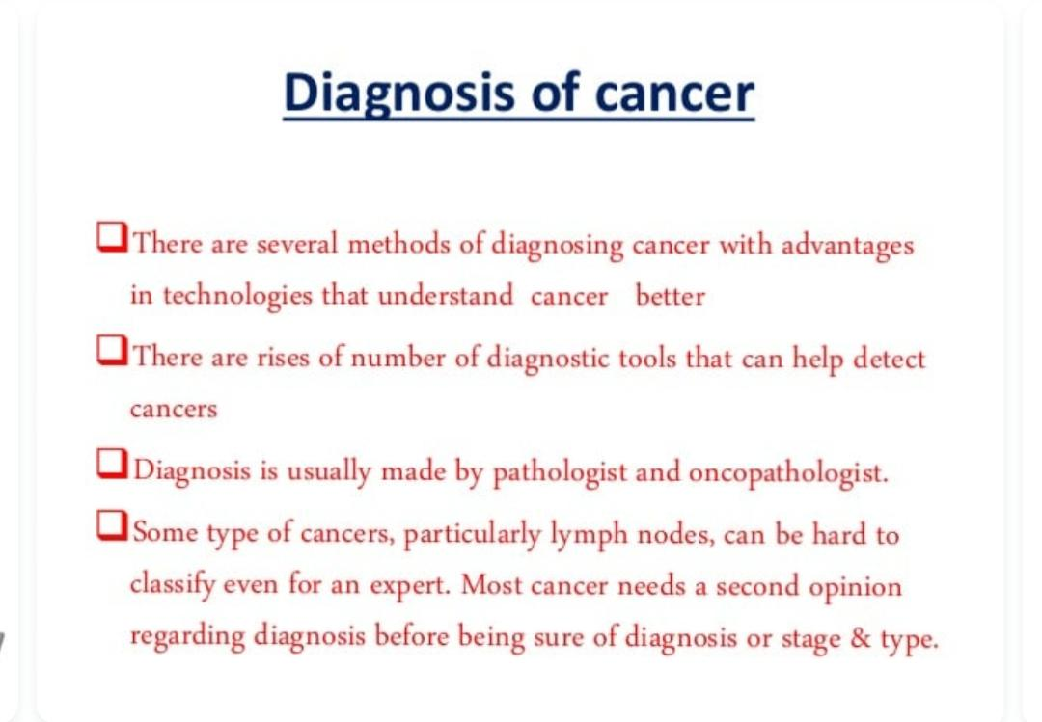

Slide 3
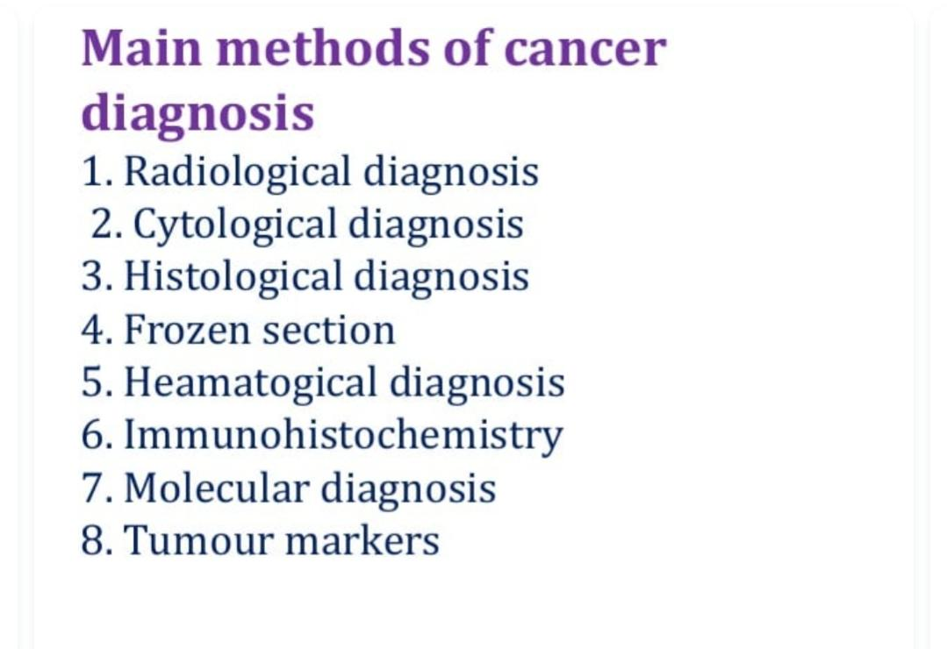

Slide 4
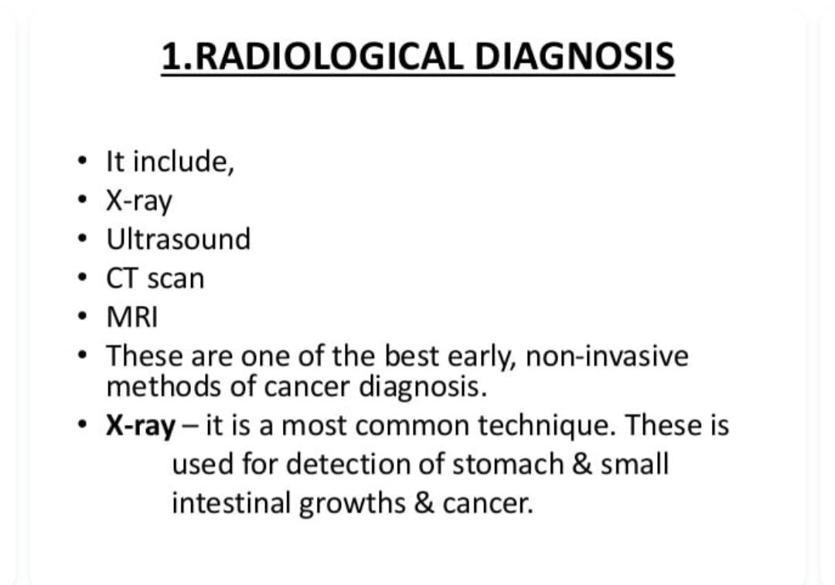

Slide 5
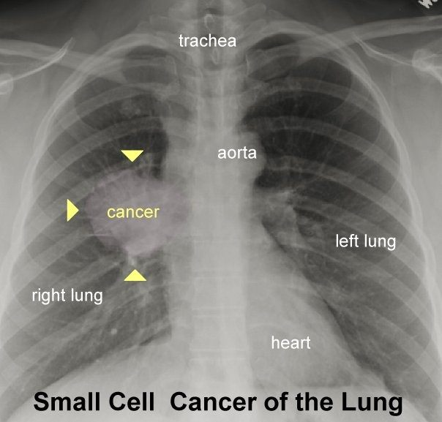
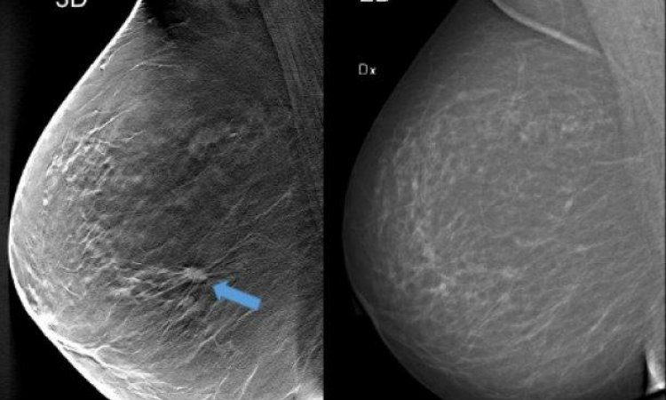
X-rays are also used in cancer diagnosis. For example, chest radiographs and mammograms are often used for early cancer detection or to see if cancer has spread to the lungs or other areas in the chest. Mammograms use X-rays to look for tumors or suspicious areas in the breasts.
35 years old >

Slide 6
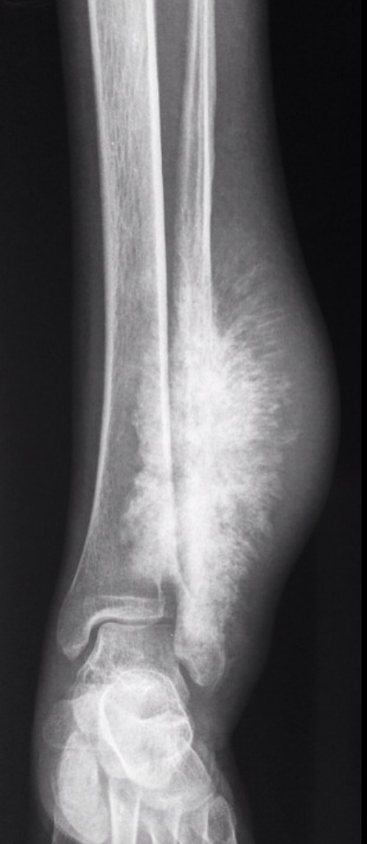
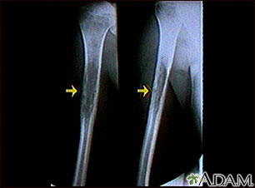
Osteosarcoma
Ewing sarcoma

Slide 7
An ultrasound (also known as ultrasonography, sonography, or sonogram) helps doctors look for tumors in certain areas of the body that don't show up well on x-rays. Doctors often use this procedure to guide a needle during a biopsy.
Ultrasound is very good at getting pictures of some soft tissue diseases that don’t show up well on x-rays. Ultrasound is also a good way to tell fluid-filled cysts from solid tumors because they make very different echo patterns. It’s useful in some situations because it can usually be done quickly and doesn’t expose people to radiation.
Ultrasound images are not as detailed as those from CT or MRI scans. Ultrasound cannot tell whether a tumor is cancer. Its use is also limited in some parts of the body because the sound waves can’t go through air (such as in the lungs) or through bone.
Special ultrasound machines, known as Doppler flow machines, can show how fast and in which direction blood flows through vessels. This is helpful because blood flow in tumors is different from that in normal tissue. Some of these machines make color pictures. Color Doppler has made it easier for doctors to find out if cancer has spread into blood vessels, especially in the liver and pancreas.

Slide 8
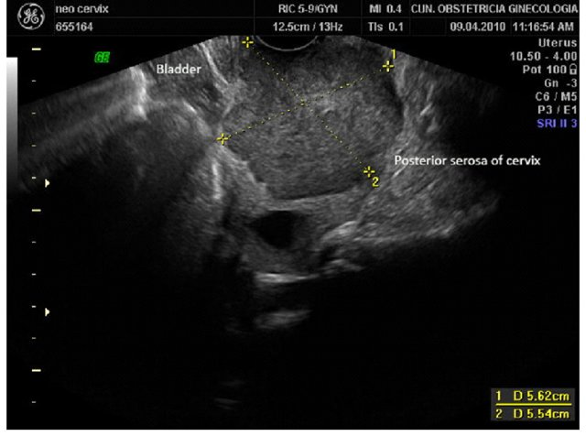
Transvaginal ultrasound showing a large cervical cancer in longitudinal plane. Deep stromal invasion is suspected. The limits of the lesion are close to cervical serosa

Slide 9
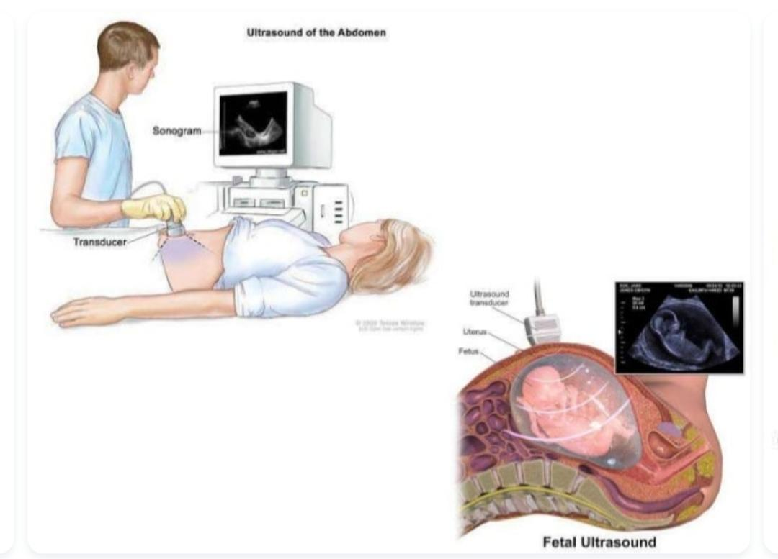

Slide 10

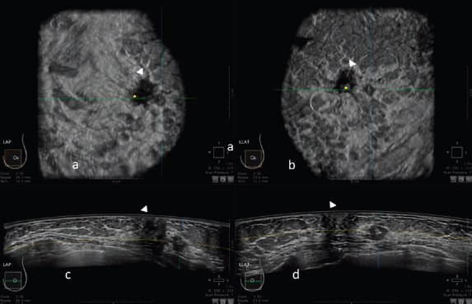
Automatic breast ultrasound: state of the art and future perspectives

Slide 11
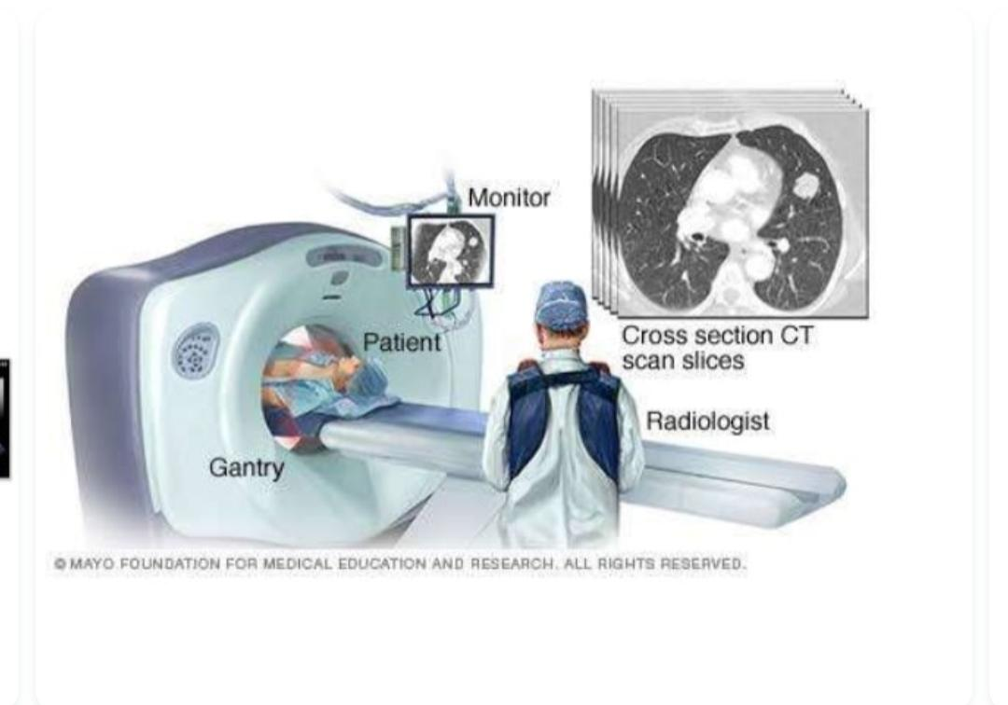
MRI

Slide 12
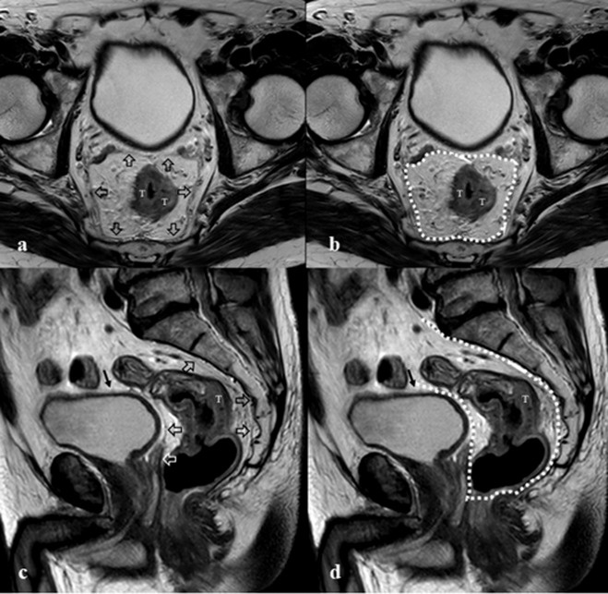
Colon cancer

Slide 13
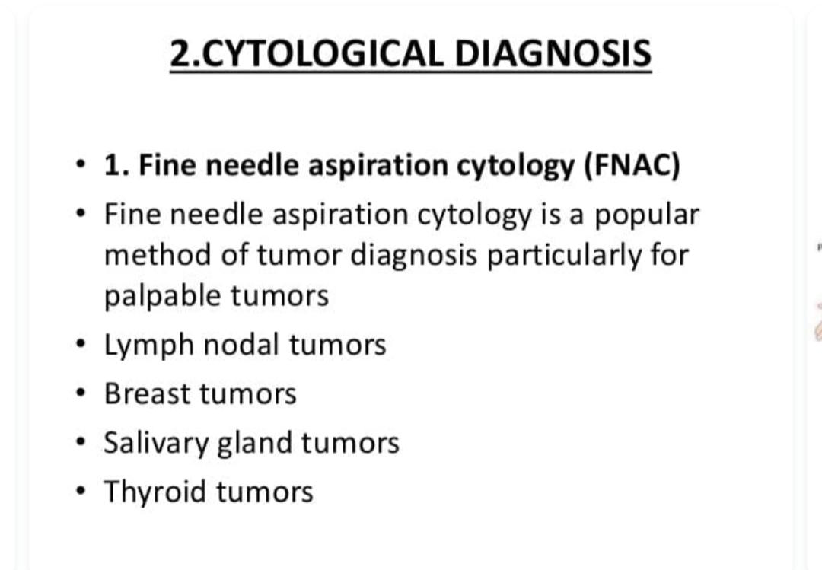

Slide 14
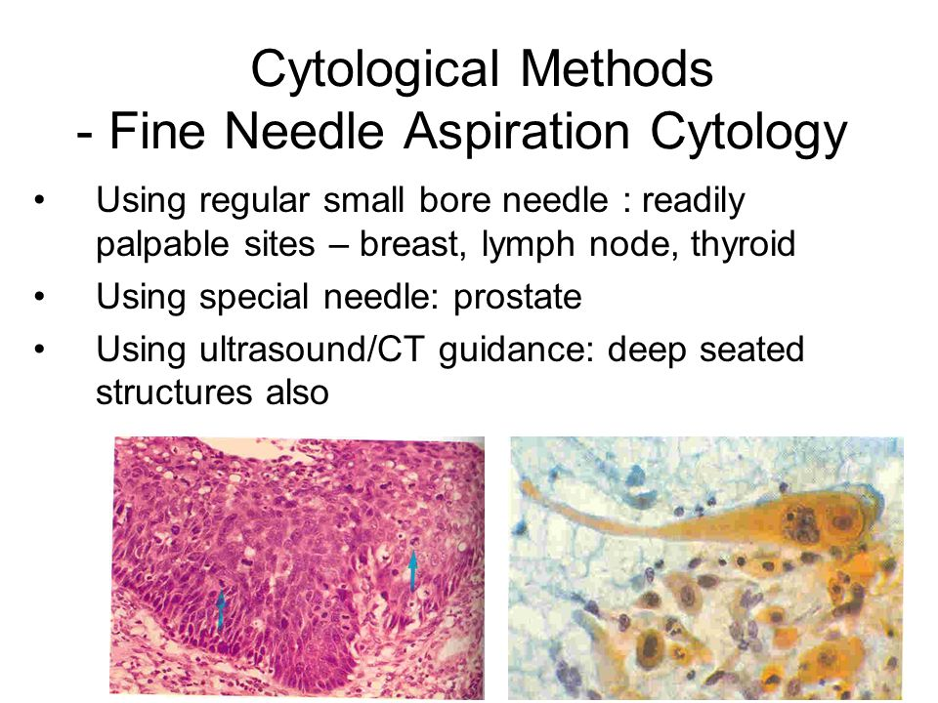

Slide 15
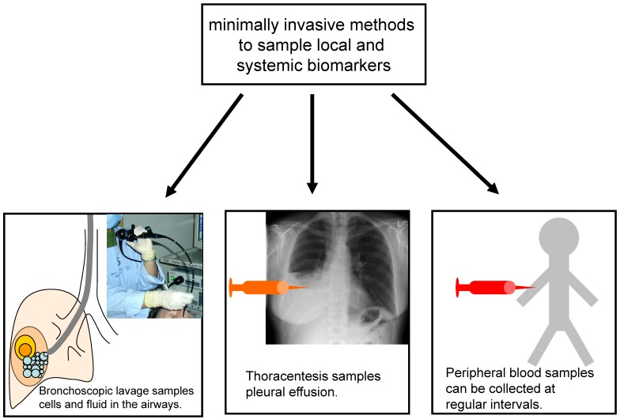

Slide 16
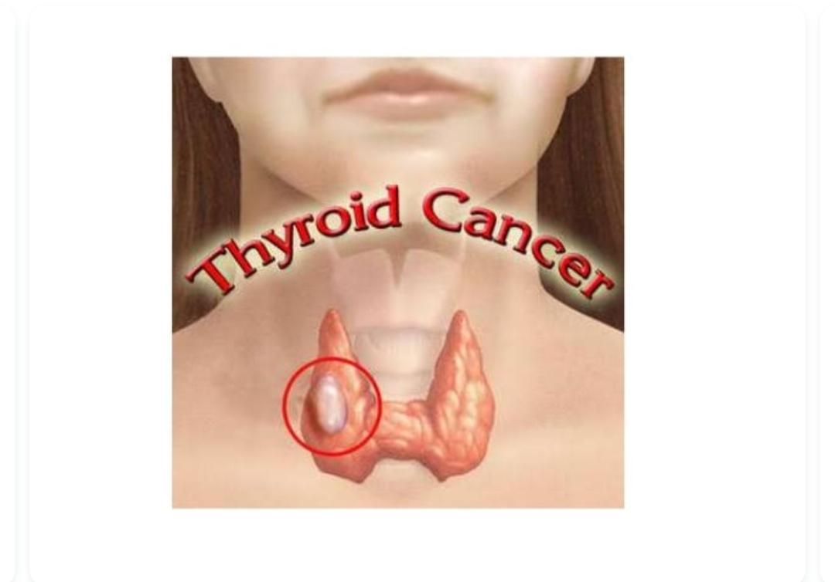

Slide 17
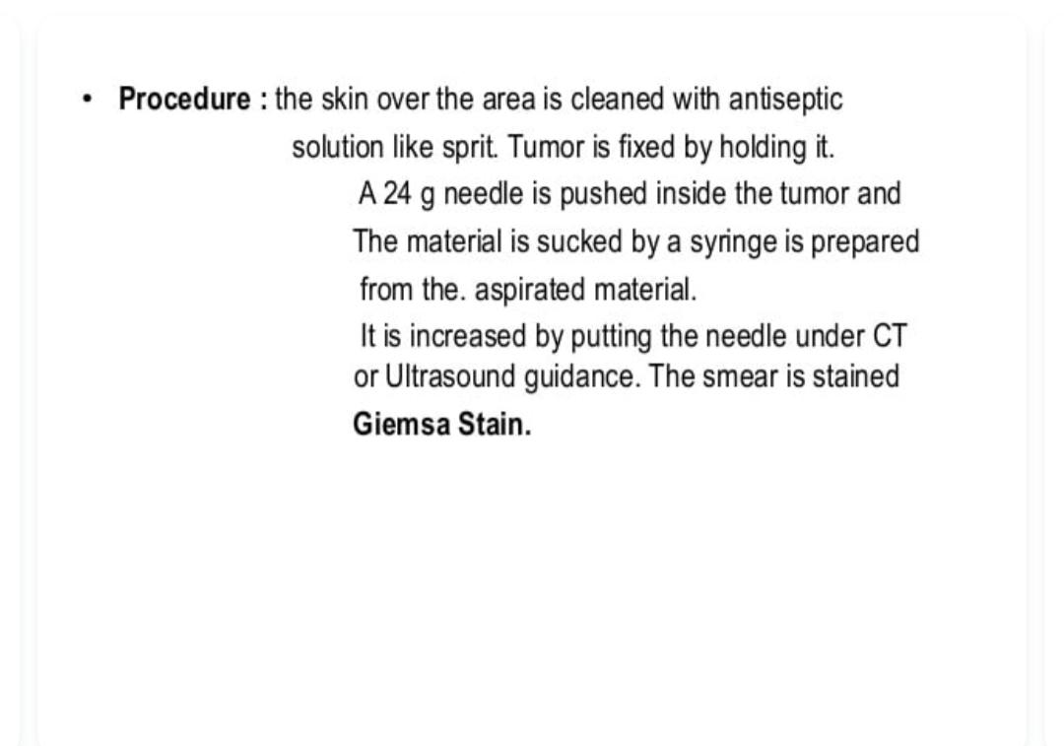
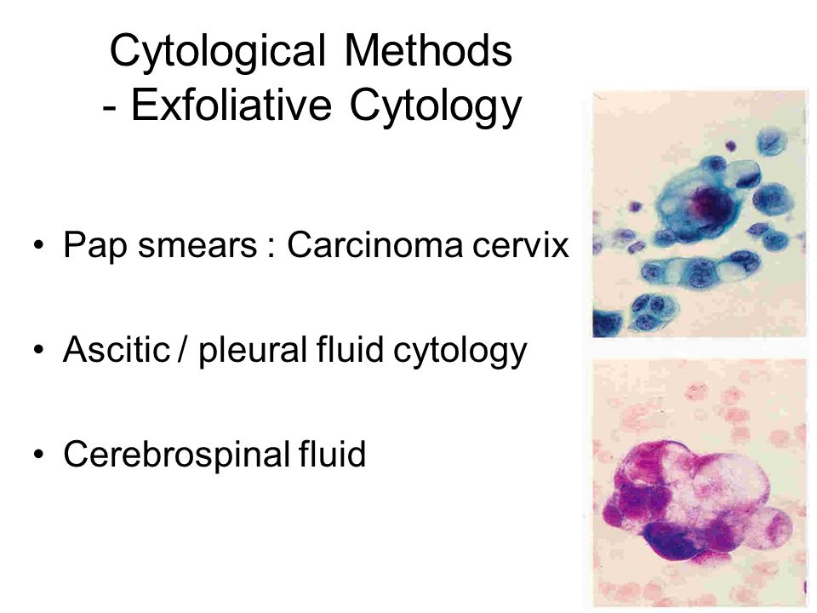

Slide 18
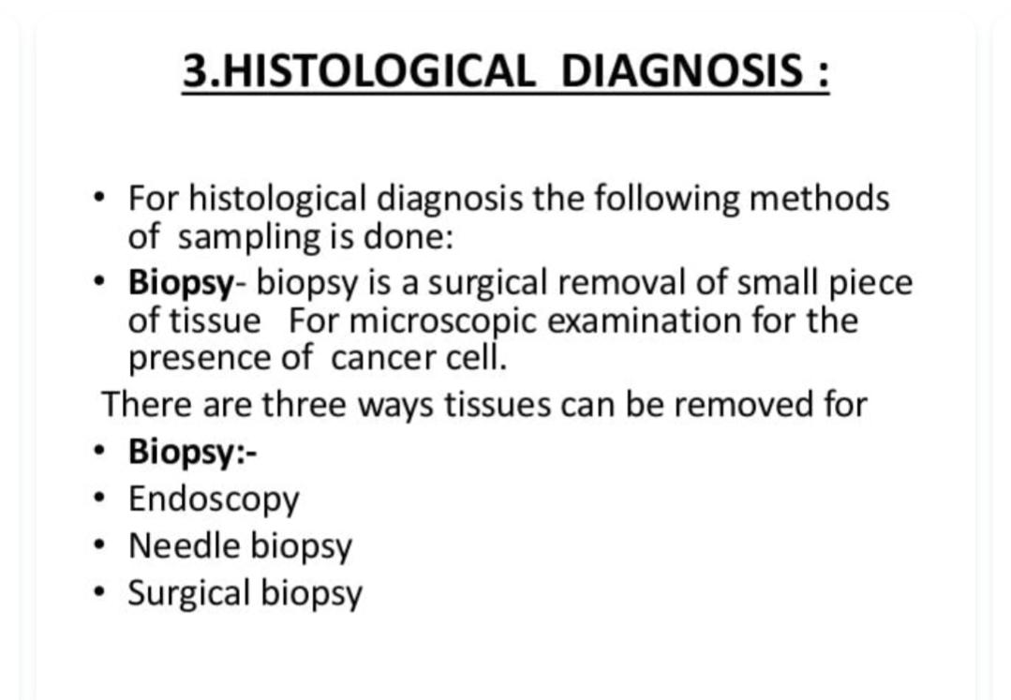

Slide 19
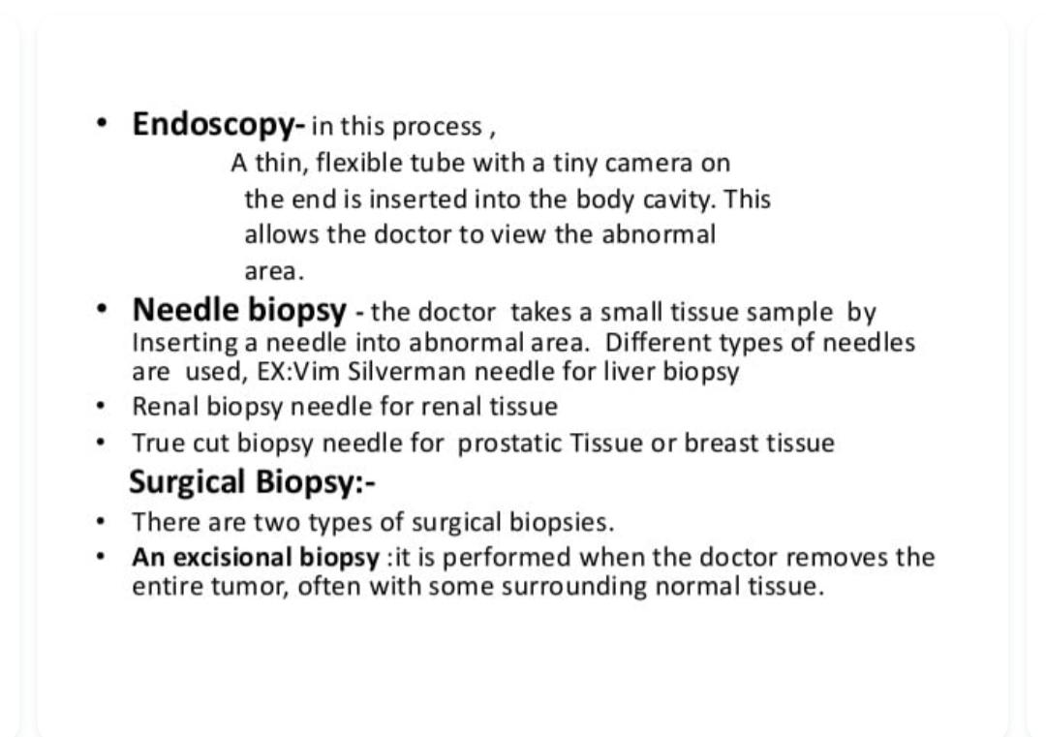

Slide 20
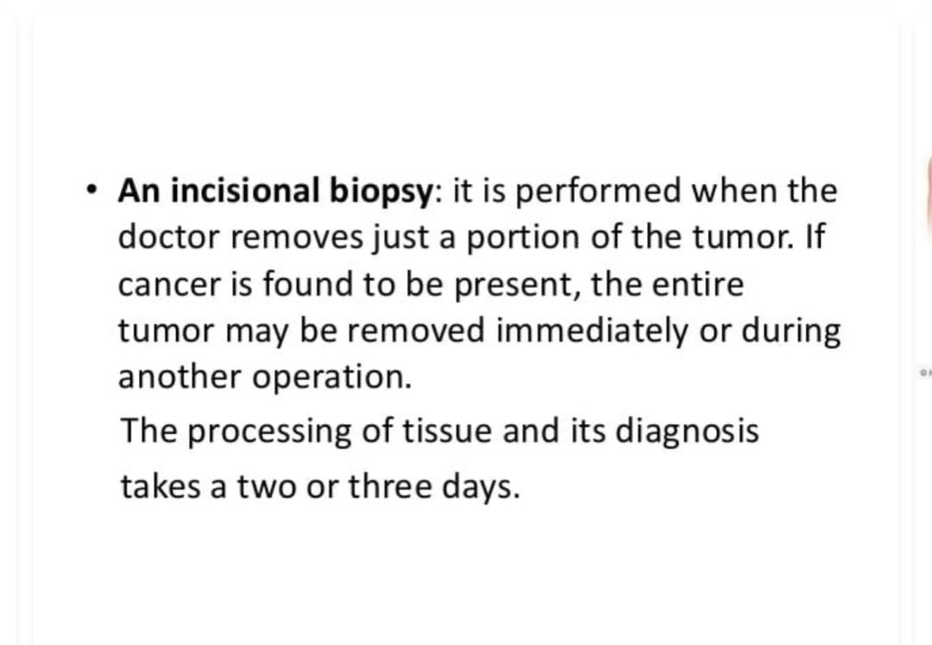
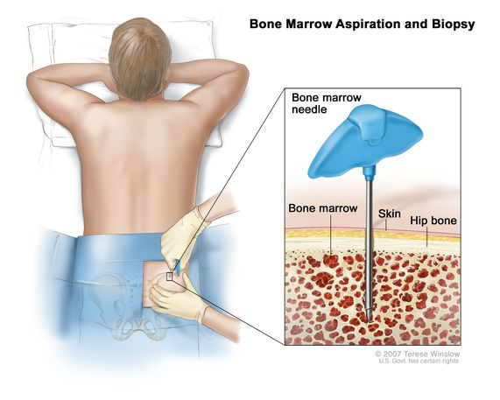

Slide 21
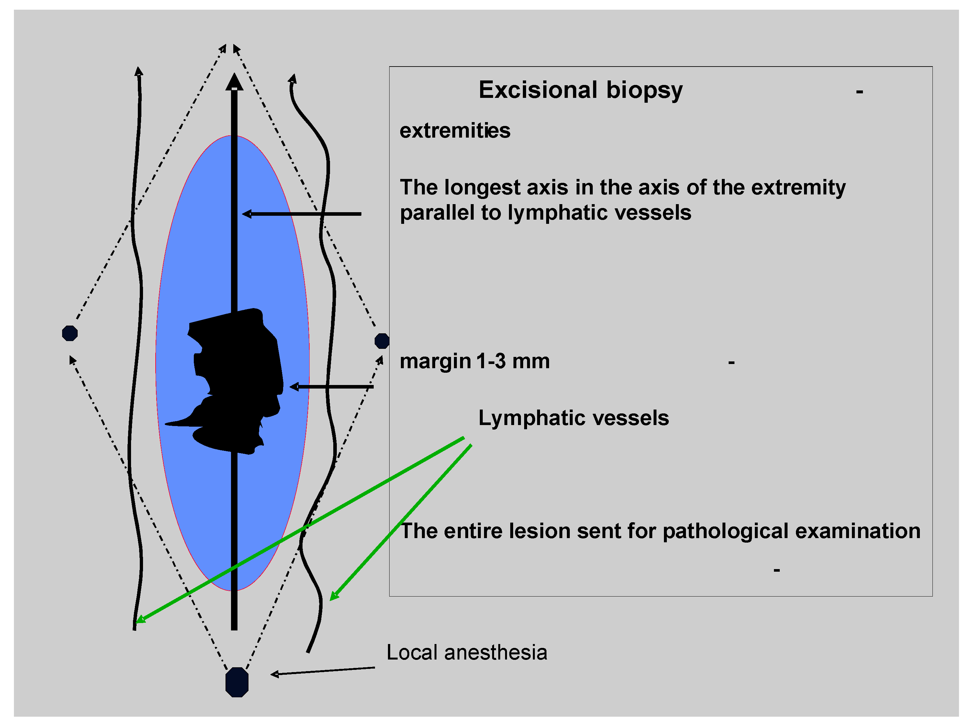

Slide 22
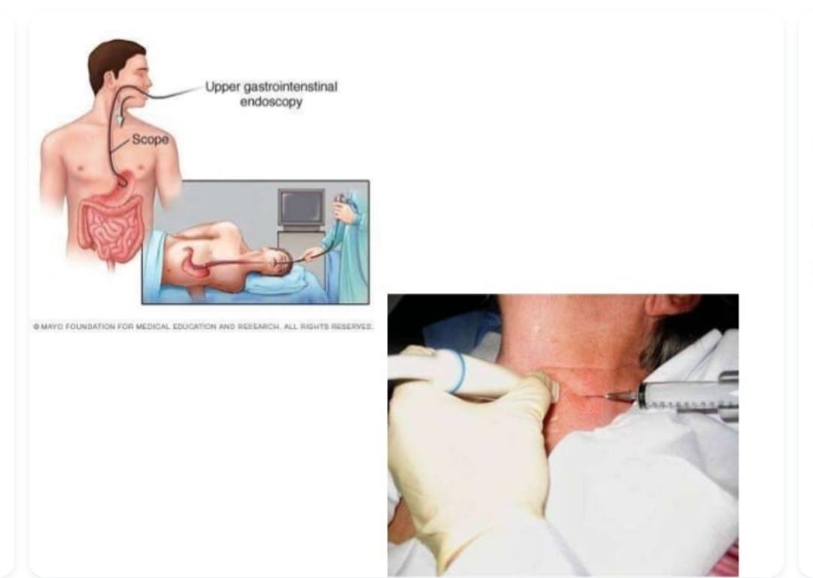

Slide 23
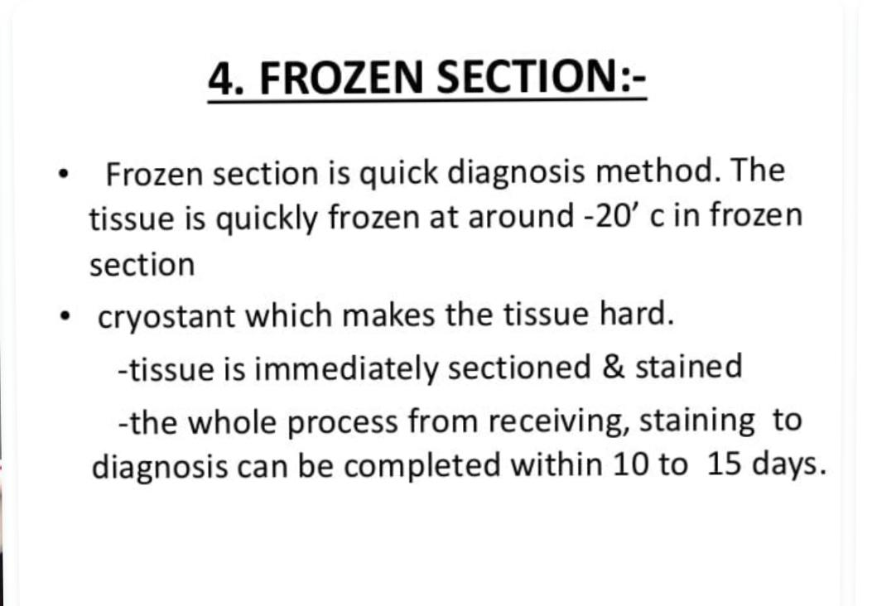

Slide 24

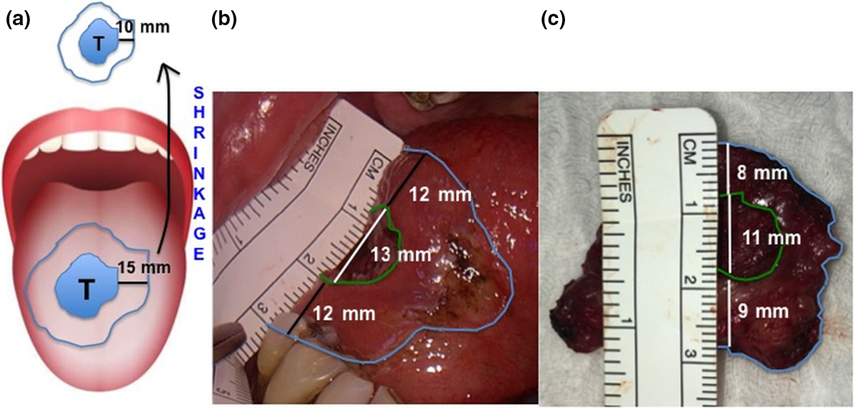
Wiley Online Library
Frozen sections and complete resection in oral cancer surgery

Slide 25
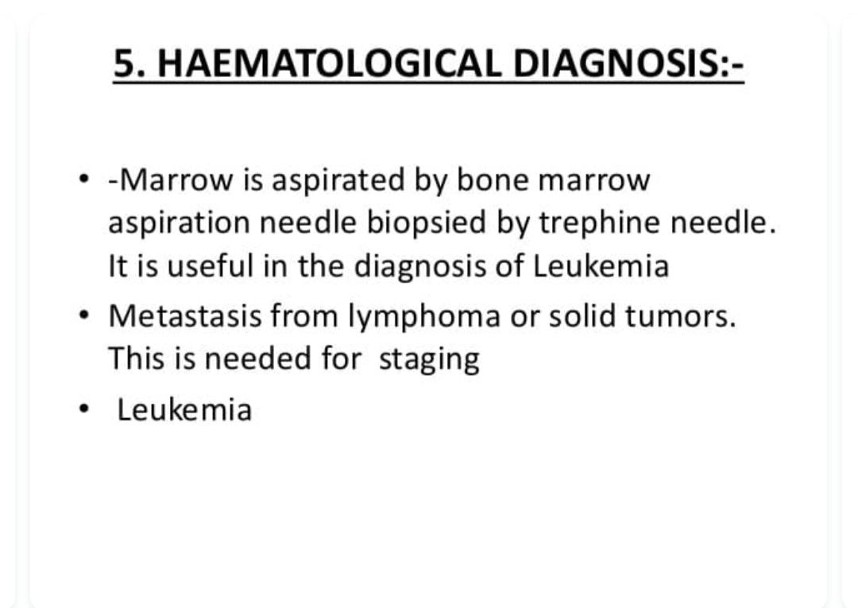

Slide 26
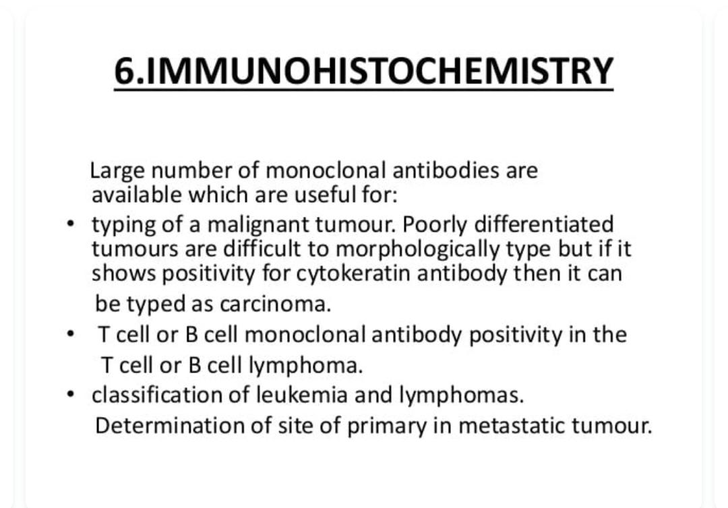

Slide 27
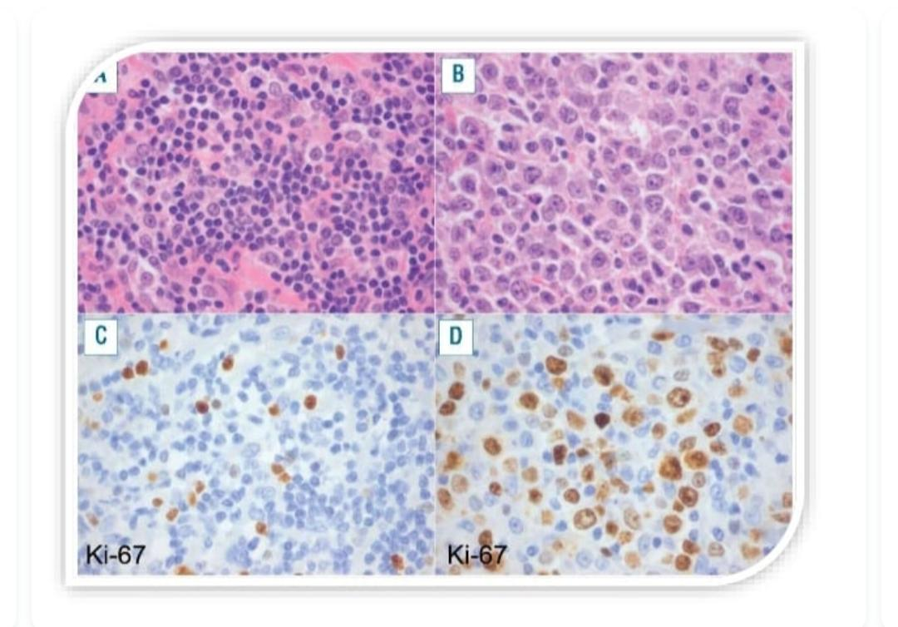

Slide 28
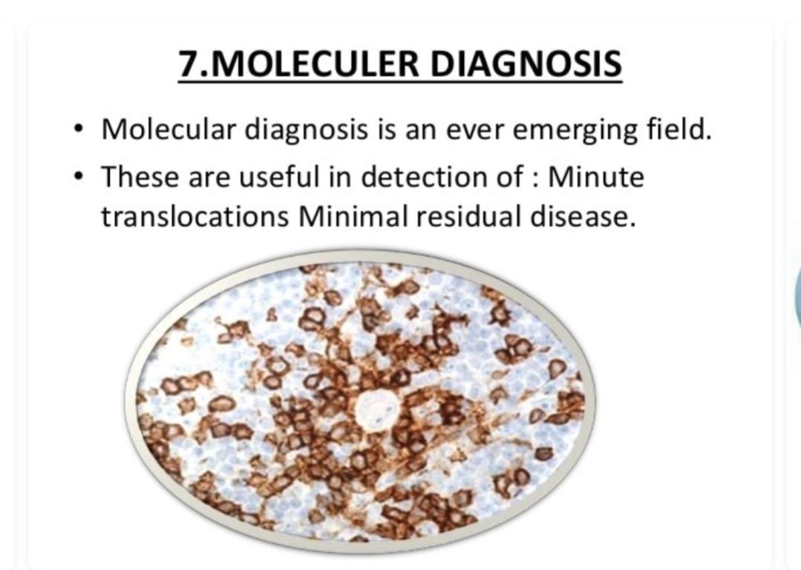

Slide 29
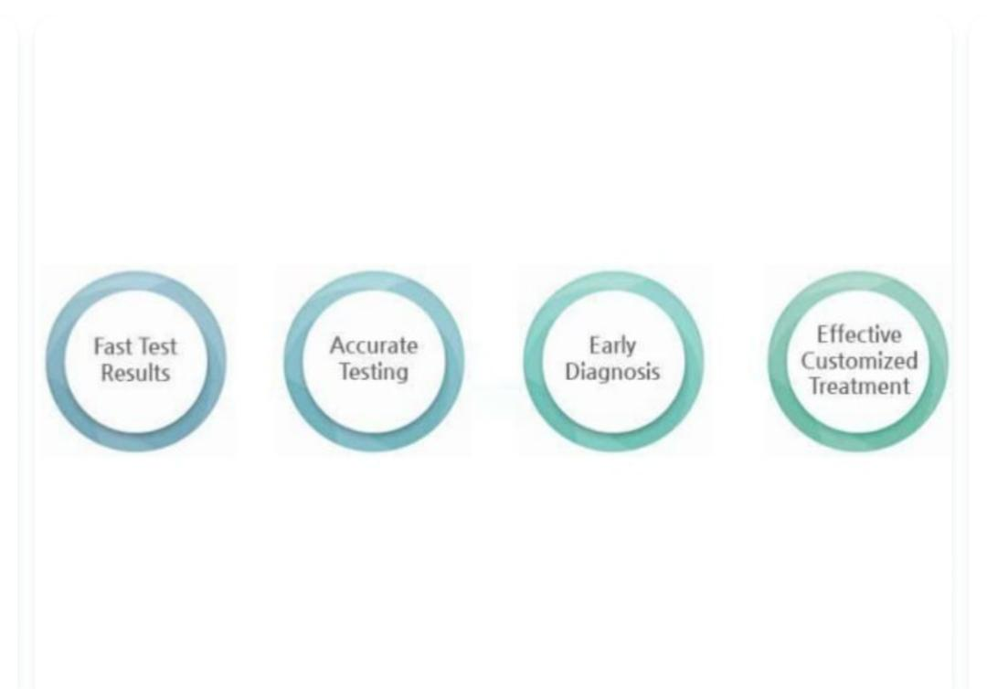

Slide 30
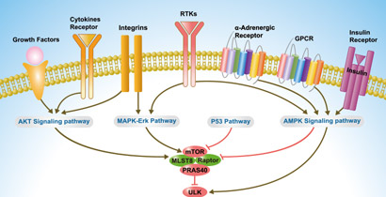

Slide 31
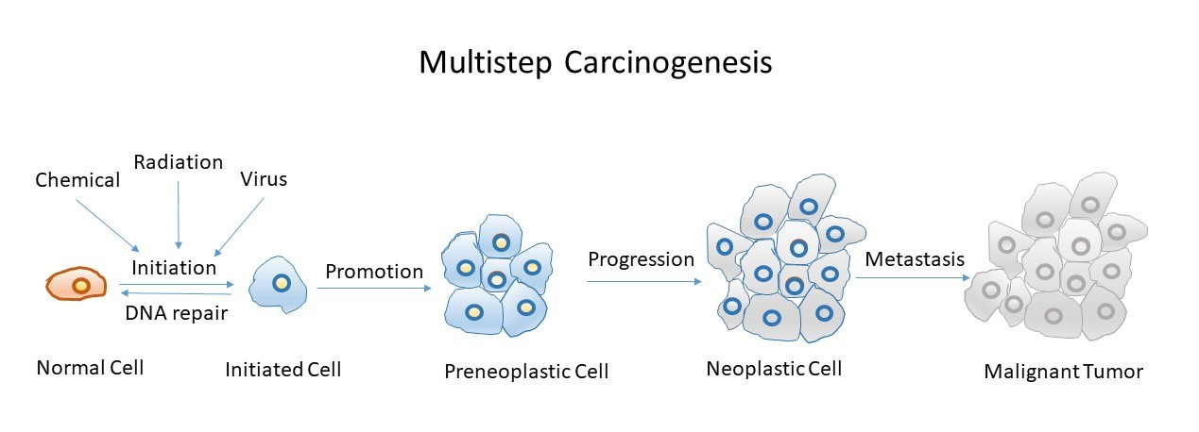

Slide 32
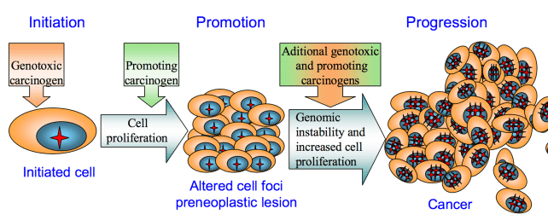

Slide 33
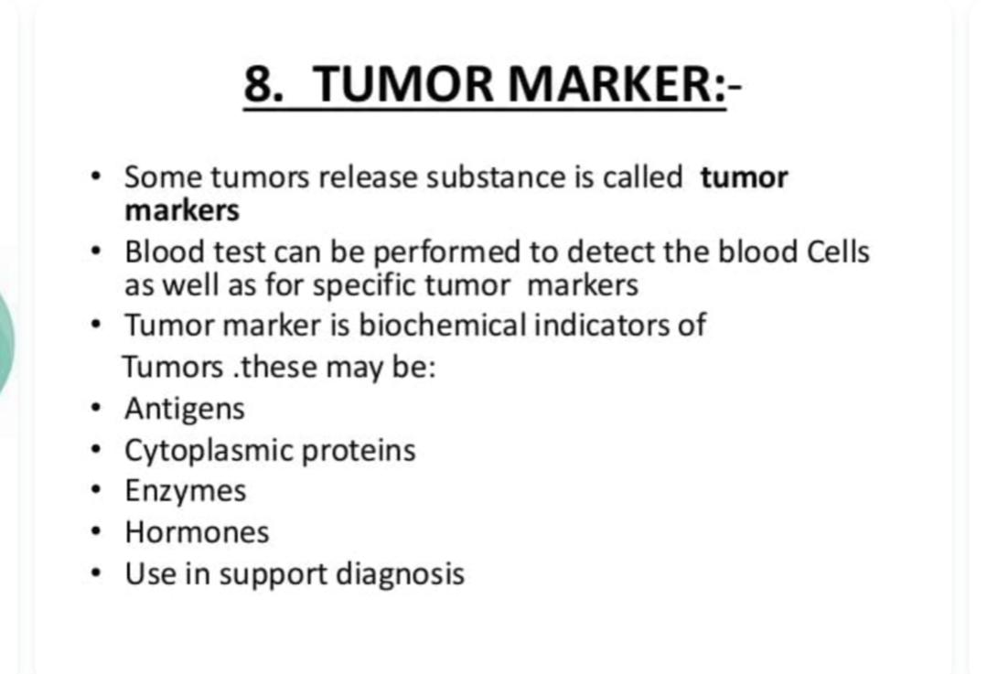

Slide 34
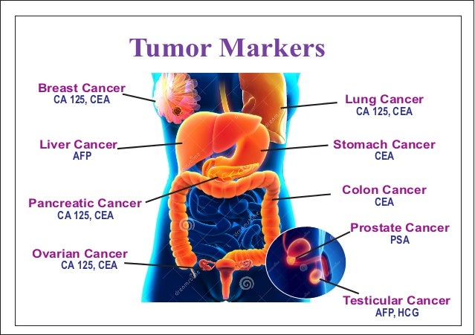

Slide 35
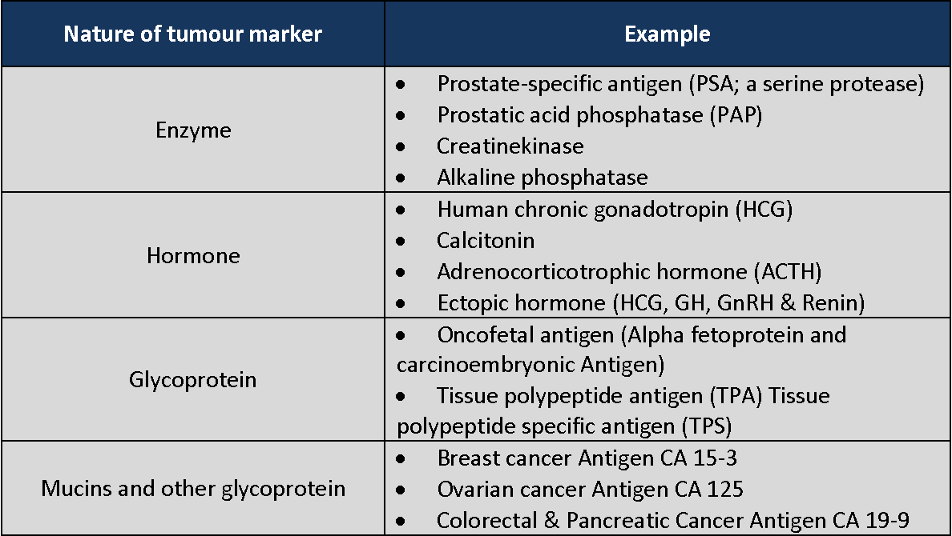

Slide 36
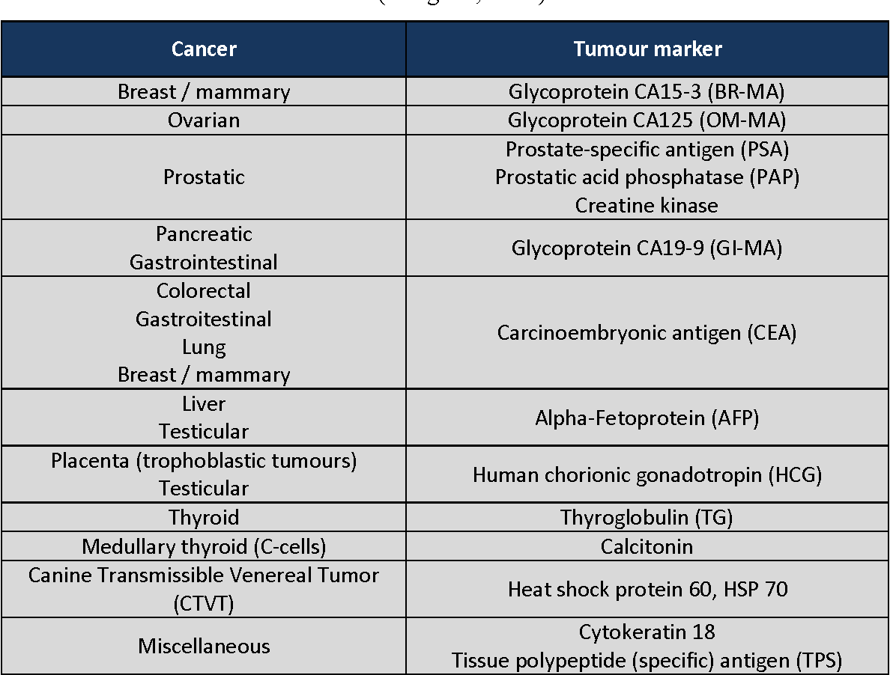

Slide 37
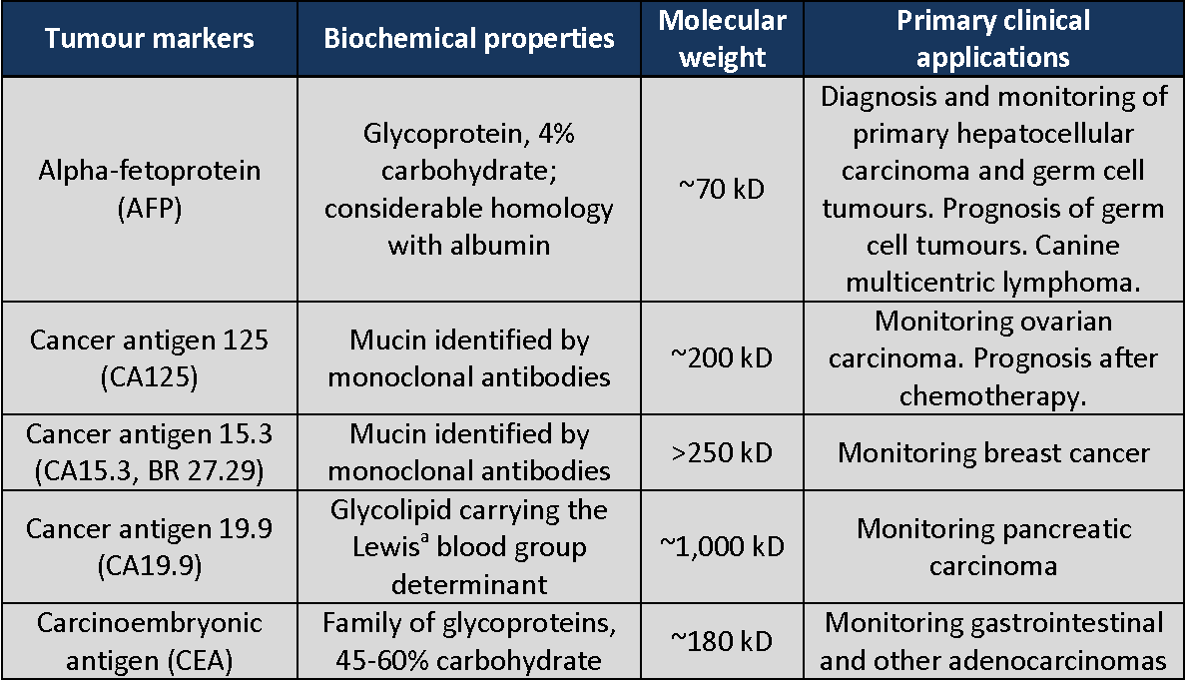

Slide 38


